Slide 1

OpenAI API
Responses
two

Slide 2
Looking at the Differences
model
messages input
response_format text
temperature
stream
max_completion_tokens max_output_tokens
stop
top_p
frequency_penalty
presence_penalty
Notes:
from openai import OpenAI
client = OpenAI()

Slide 3
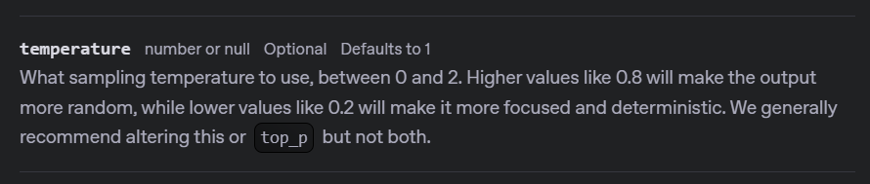
Notes:
https://platform.openai.com/docs/api-reference/responses/create#responses-create-temperature

Slide 4
response = client.responses.create(
model="gpt-4o-mini",
input=[
{"role": "developer", "content": "You are a brilliant author of children's books."},
{"role": "user", "content": "Write two paragraphs about a frog."}
],
text=None,
temperature=0
)

Slide 5
DEMO: Temperature

Slide 6
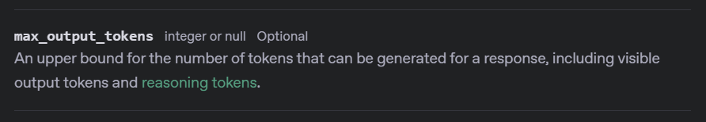
Notes:
https://platform.openai.com/docs/api-reference/responses/create#responses-create-max_output_tokens
https://platform.openai.com/docs/models/gpt-4o-mini

Slide 7
response = client.responses.create(
model="gpt-4o-mini",
input=[
{"role": "developer", "content": "You are a brilliant author of children's books."},
{"role": "user", "content": "Write two paragraphs about a frog."}
],
text=None,
temperature=None,
max_output_tokens=1000
)

Slide 8
DEMO: Max Output Tokens

Slide 9



Slide 10




Notes:
https://www.youtube.com/channel/UC35ZpwldGw7ZJ5R-2sLijzw

Slide 11
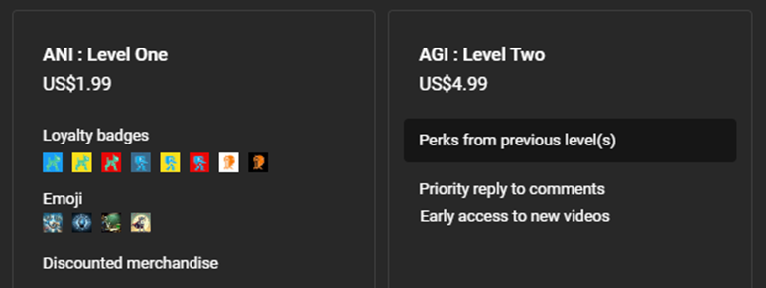
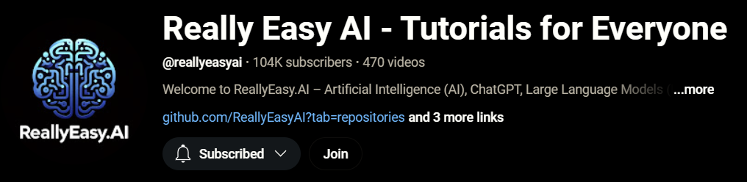
Notes:
https://www.youtube.com/@reallyeasyai/join

Slide 12

https://shop.reallyeasy.ai
Notes:
https://shop.reallyeasy.ai

Slide 13

https://www.youtube.com/@ainewsfresh
Notes:
https://www.youtube.com/@ainewsfresh

Slide 14

https://www.youtube.com/@aipaperspodcastdaily
Notes:
https://www.youtube.com/@aipaperspodcastdaily

Slide 15
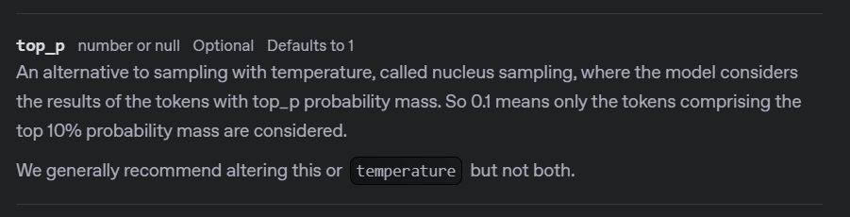
Notes:
https://platform.openai.com/docs/api-reference/responses/create#responses-create-top_p

Slide 16
response = client.responses.create(
model="gpt-4o-mini",
input=[
{"role": "developer", "content": "You are a brilliant author of children's books."},
{"role": "user", "content": "Write two paragraphs about a frog."}
],
text=None,
temperature=None,
max_output_tokens=None,
top_p=0.01,
)

Slide 17
DEMO: Top P (Nucleus Sampling)

Slide 18
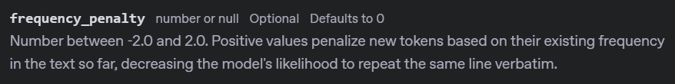
Notes:
https://platform.openai.com/docs/api-reference/chat/create#chat-create-frequency_penalty

Slide 19
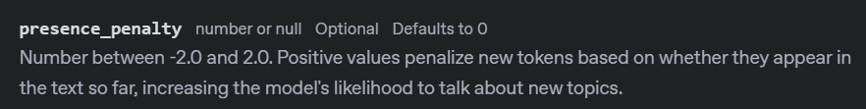
Notes:
https://platform.openai.com/docs/api-reference/chat/create#chat-create-presence_penalty

Slide 20
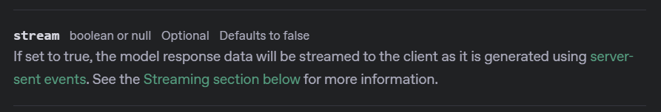
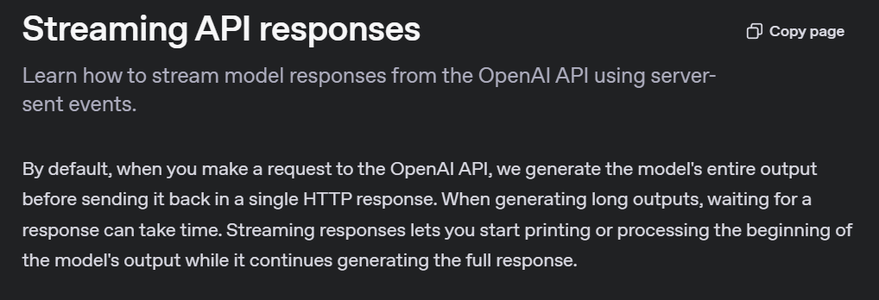
Notes:
https://platform.openai.com/docs/api-reference/responses/create#responses-create-stream
https://platform.openai.com/docs/api-reference/responses-streaming
https://platform.openai.com/docs/guides/streaming-responses?api-mode=responses

Slide 21


Non-Streaming Response
How are you?
Wait for Processing
Full Response
I am great!

Slide 22
Streaming Response
How are you?
I
am
great
!

Slide 23
stream = client.responses.create(
model="gpt-4o-mini",
input=[
{"role": "developer", "content": "You are a brilliant author of children's books."},
{"role": "user", "content": "Write two paragraphs about a frog."}
],
text=None,
temperature=None,
max_output_tokens=None,
top_p=None,
stream=True
)
for event in stream:
if event.type == "response.output_text.delta":
print(event.delta, end='', flush=True)

Slide 24
DEMO: Streaming Responses

Slide 25
OpenAI API
Responses
two

